Slide 1
ETM 545: project Management
Sustainable PSU Campus Proposal
Team Verde: Aditi Vijay Sonawane
Notes:
Meg

Slide 2
Agenda
01
06
02
07
03
08
04
09
05
10
Objectives
Resources
Work Breakdown Structure
Risk Management
Schedule
Control System
Network Diagram
Termination Plan
Cost
Conclusion
Notes:
Objective & Proposal - Meg
WBS - Francois/Aditi
Schedule - Aditi
Network diagram - Meg
Cost - Annie
Resources - Minoti (Hope you will talk about stakeholders in this)
Risk Management - Minoti
Control System - Annie
Termination Plan - Francois
Conclusion - Aditi

Slide 3
Objectives
Design
Sustainability
Community
Cost
Develop and submit a sustainable redesign plan to Portland State University’s Sustainability office for the Smith Memorial Student Union building.
Focus on implementation of energy efficient systems, carbon reduction strategies, and inclusive spaces in line with the United Nations’ Sustainable Development Goals.
Increase opportunities for educational programming and community involvement within SMSU and reinforce its role as a central student hub.
Project timeline of March 1st 2025 - June 30th 2025 and within a budget of $24,000
Notes:
meg

Slide 4
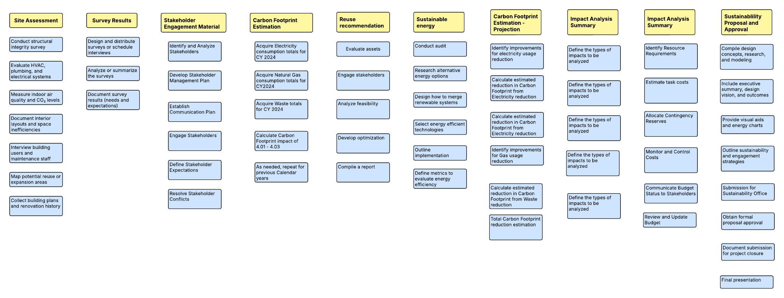
Work BreakDown Structure
Notes:
aditi

Slide 5
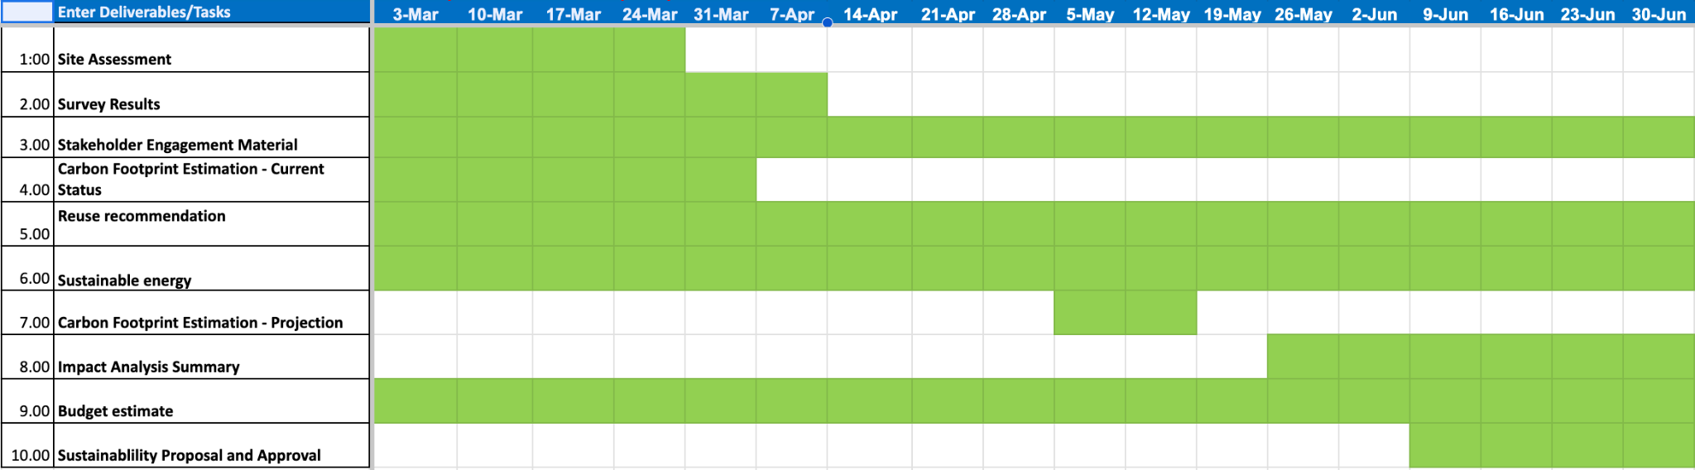
Schedule
Notes:
aditi

Slide 6
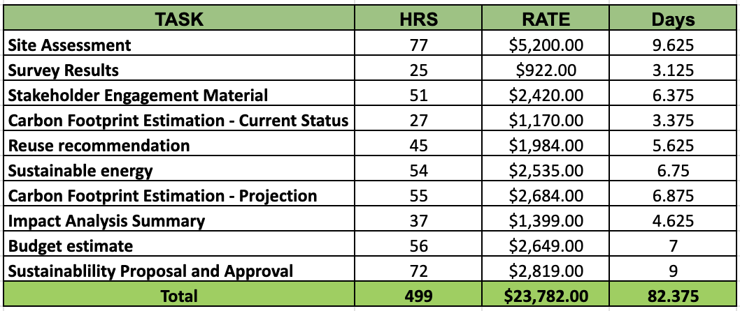
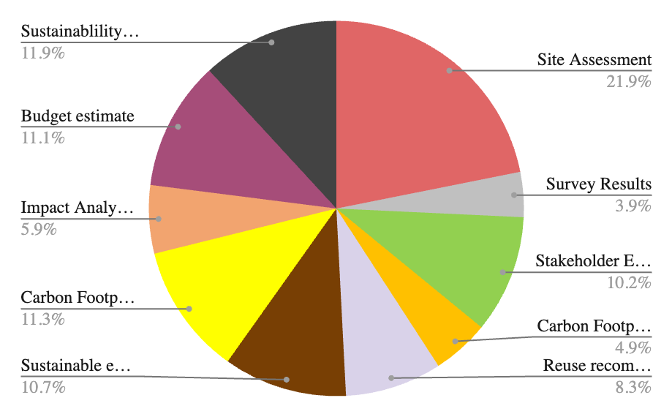
Project Expense
The total projected budget for the proposal is $23,782, spread across 10 key deliverables over approximately 82.4 days (or ~12.5 work weeks for a single full-time person).
Table: Project Expense Breakdown
Fig: Deliverable cost distribution
Notes:
Annie

Slide 7
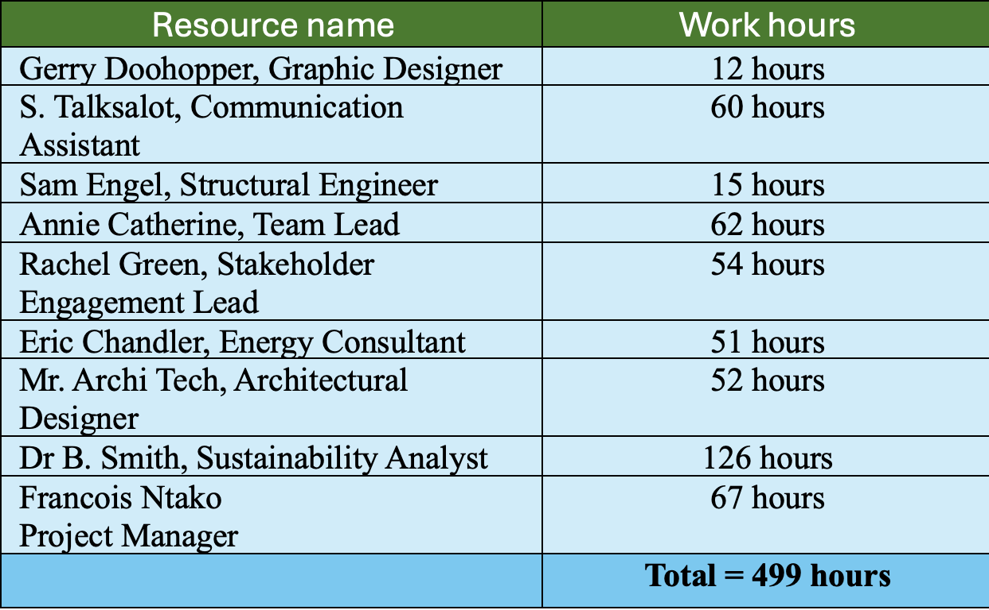
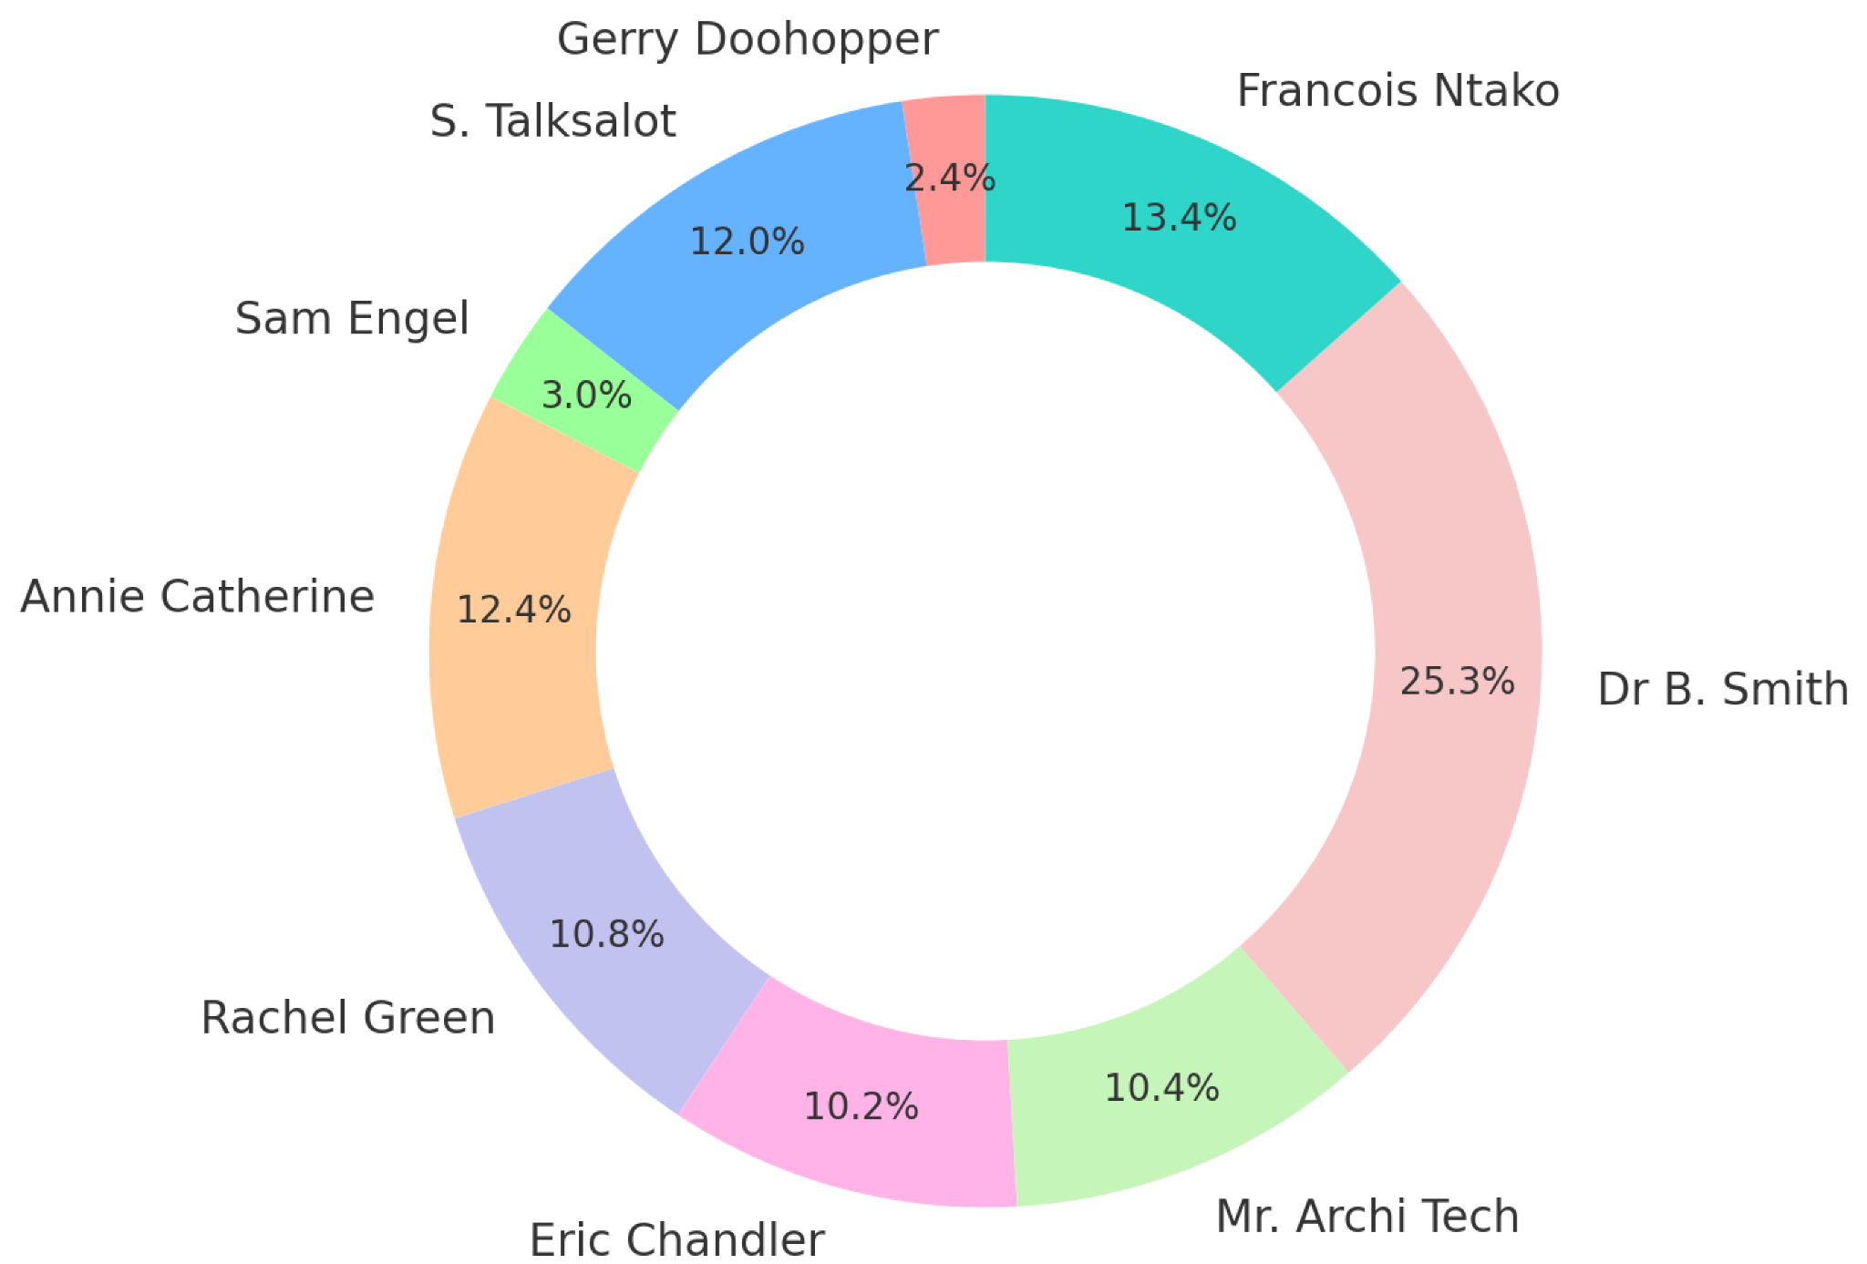
RESOURCES
Total Labor Hours: 500 hours (approx)
Team Members: 9 core contributors
Timeline:1st March, 2025 – 30th June, 2025
Cost Estimate: $23,782.38 (approx. 24,000)
Labor: $23,567.38
Non-Labor: $215 (surveys, stakeholder tools)
Table: Work Hour Distribution by Resources
Fig: Percentage contribution by Resources
Notes:
Minoti

Slide 8
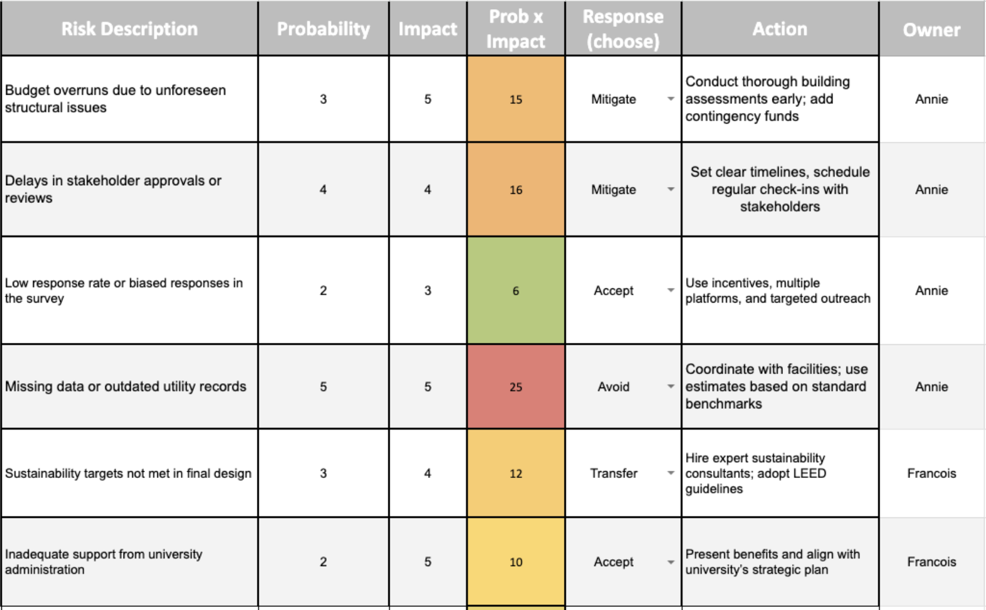
RISK MANAGEMENT
There are a total of 13 risks that the team identified.
Table: Risk Matrix
Notes:
minoti

Slide 9

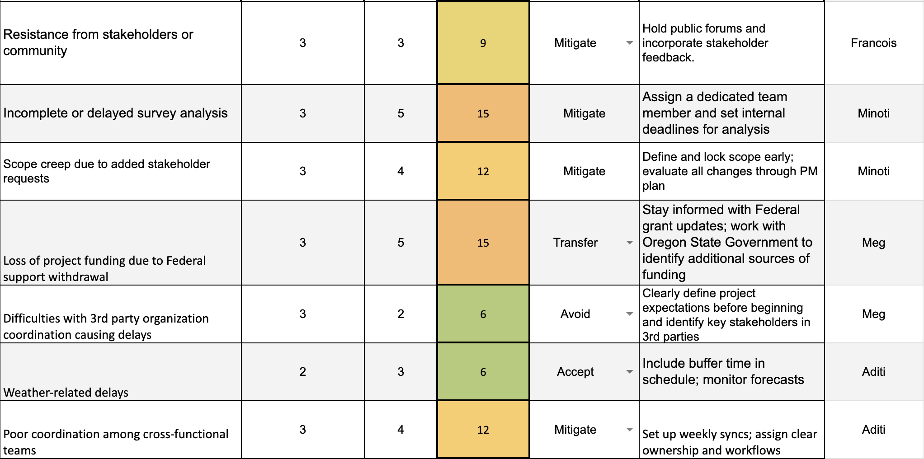
RISK ManageMent
Table: Risk Matrix
Notes:
minoti

Slide 10
AoN Diagram
Critical Path: 38 Days
1
2
7
7.01
7.02
1
2
2
7.03
7.04
7.07
1
2
1
1
7.05
7.06
9
1
4
5
6
1
1.01
4.01
1
1
1
1
9.04
1
1
1
1
1
1
1
1
5.01
5.03
6.01
6.03
1
1
1.02
1.04
1.05
1.06
1.07
4.02
4.04
4.05
6.05
6.06
1
2
2
1
1
2
1
2
9.01
9.02
9.03
9.05
9.07
1
1
5.02
5.04
5.05
6.02
6.04
1
1.03
4.03
2
2
8
9.06
Start
2
1
8.02
2
1
1
8.01
2
8.04
8.05
8.06
8.03
2
3
10
2
1
1
2
2
1
2
3.02
1
1
1
10.01
10.03
1
1
1
2.01
2.02
2.03
3.01
3.04
3.05
3.06
1
1
10.05
10.06
10.07
10.08
3.03
10.02
10.04
2
Notes:
meg

Slide 11
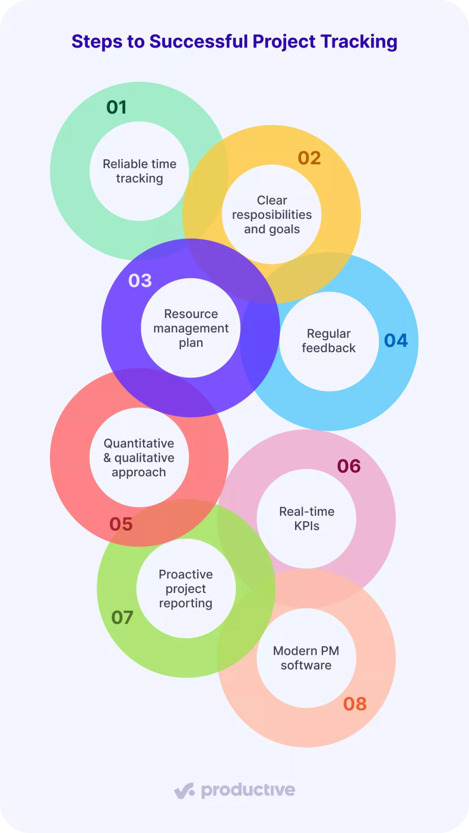
Project Control System – Staying on Track
Schedule Control
Tools like Trello or Smartsheet used to track deadlines and dependencies
Weekly progress reviews and team stand-ups to adjust timelines
Budget Control
Estimated costs per deliverable with ±$500 variance tolerance
Weekly financial tracking via spreadsheets or budget tools
Risk Management:
Live risk register with owner, impact, and mitigation plan
Weekly risk reviews and 10% buffer for unplanned issues
Communication Plan:
Weekly syncs (team), biweekly briefs (sponsor), milestone updates (stakeholders)
Notes:
Annie

Slide 12
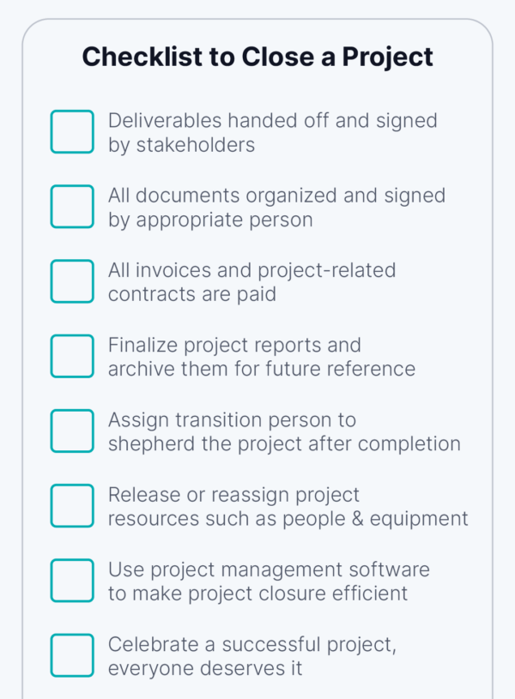
Project Closure & Post-Implementation Review
Deliverables Submission:
Final sustainability proposal with cost estimates & timeline
Formal review by PSU Sustainability Office & Administration
Final Documentation:
Project report with outcomes, feedback, metrics, and risk summary
Lessons learned for future sustainability projects
Closure Activities:
Team/resource release, contract closures, system updates
Post-Implementation Review:
Evaluate goals met, timeline adherence, and improvement areas
Archive findings and share with PSU leadership
Notes:
Annie

Slide 13
Termination Plan
Final deliverables
Proposal with environmental strategies
Cost estimates
Timelines
Stakeholder approvals
Project closure activities
Financial summary
Stakeholder feedback
Lessons learned
Sprint retrospective
Team performance evaluation
Insights for continuous improvement
Administrative tasks
Contract closures
File archiving
Personnel
Equipment reassignment
Final deliverables
Post-implementation Review
Sustainability goal assessment
Budget adherence
Engagement outcomes
Final validation
Internal project oversight committee approval
Ensuring full project buyoff
Conclusion:
Summary of impact
Future sustainability initiatives
Closing acknowledgments
Notes:
Francoi

Slide 14
ConCLUSION
To successfully deliver the proposed sustainable redesign of PSU’s SMSU building, we require a budget of $24,000 and a project timeline from March to June, resulting in improved energy efficiency, reduced carbon footprint, and enhanced community engagement

Slide 15
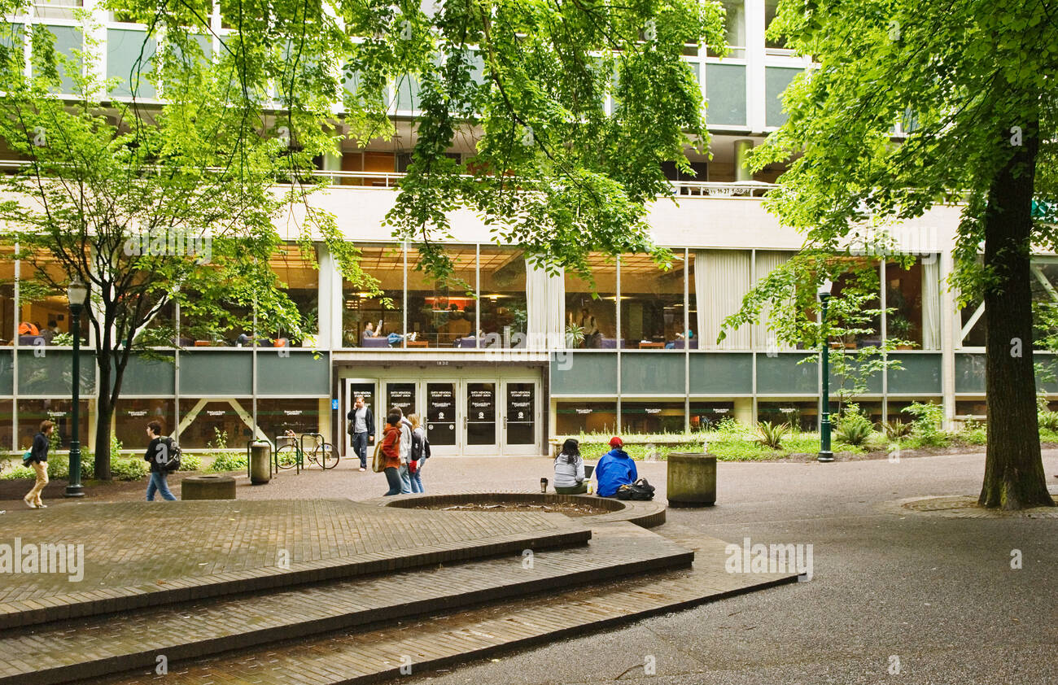
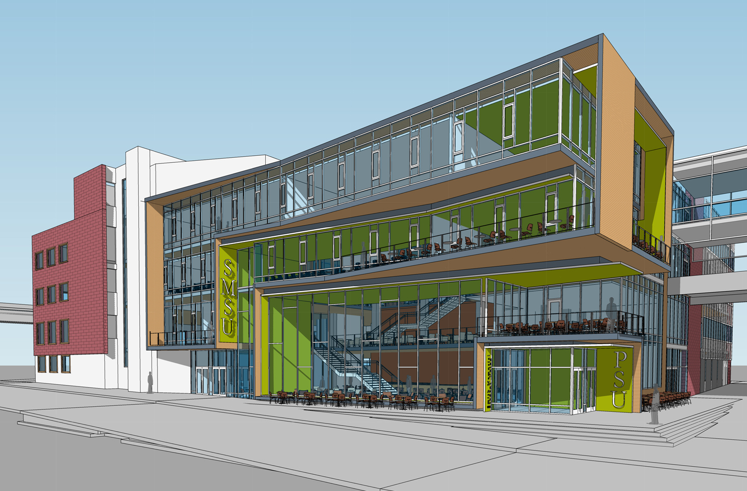
Thank You

